Slide 1
LECTURE 11
INTRODUCTION TO EPISTEMOLOGY
(THEORY OF KNOWLEDGE)

Slide 2
WHAT IS THE THEORY OF KNOWLEDGE?
THEORY OF KNOWLEDGE, ALSO CALLED “EPISTEMOLOGY” IS THE PHILOSOPHICAL DISCIPLINE THAT ATTEMPTS TO:
(1) DEFINE KNOWLEDGE
(2) DETERMINE THE SOURCES OF KNOWLEDGE – AND PROPOSE THEORIES AS TO HOW SUCH KNOWLEDGE IS POSSIBLE
(3) SPECIFY A CRITERION OF KNOWLEDGE
(4) DETERMINE THE LIMITS OF HUMAN KNOWLEDGE
(5) SOLVE VARIOUS PROBLEMS AND PARADOXES ABOUT KNOWLEDGE.

Slide 3
OBVIOUS SOURCES OF KNOWLEDGE
PERCEPTION BY MEANS OF THE SENSES: SIGHT, TOUCH, HEARING, SMELL, AND TASTE.
(2) INTROSPECTION
(3) MEMORY
(4) REASON
(5) TESTIMONY
ANYTHING ELSE? ETHICAL INTUITION? ESP? MYSTICAL INTUITION? FAITH? SOME KIND OF PERCEPTION OF GOD (NOT BY MEANS OF THE FIVE SENSES)?

Slide 4
SOME PROBLEMS OF EPISTEMOLOGY
HOW DO WE KNOW THAT THERE IS A PHYSICAL WORLD? OBVIOUS ANSWER: WE SEE, FEEL, HEAR, TASTE AND SMELL OBJECTS IN THE “EXTERNAL WORLD”.
SKEPTICAL QUESTION: HOW DO YOU KNOW THAT THESE EXPERIENCES ARE ACTUALLY CAUSED BY REAL OBJECTS IN SPACE AS THEY ARE PRESENTED TO YOU BY MEANS OF “QUALIA”? WHAT ABOUT DREAMS? WHAT ABOUT THE POSSIBILITY OF A MATRIX OR AN EVIL DECEIVING GOD? COULD WE BE BRAINS IN VATS?

Slide 5
ONE PHILOSOPHICAL PROJECT IS TO ANSWER SKEPTICAL ARGUMENTS
G. E. MOORE ARGUED THAT SOMETHING MUST BE WRONG WITH SKEPTICISM SINCE WE DO KNOW THAT THERE IS AN “EXTERNAL WORLD.” BUT HE DIDN’T GO ON TO EXPLAIN WHAT IS WRONG WITH THEIR ARGUMENTS. SO THE “G. E. MOORE SHIFT” WAS NOT ENTIRELY SUCCESSFUL IN THAT CASE. NOR DOES IT SEEM ENTIRELY SATISFACTORY AS A RESPONSE TO THE PROBLEM OF EVI.

Slide 6
RADICAL EMPIRICISM: ALL KNOWLEDGE IS GAINED BY MEANS OF EXPERIENCE
ACCORDING TO EMPIRICISM, EVERYTHING WE KNOW ABOUT ANYTHING ULTIMATELY DERIVES FROM SENSORY EXPERIENCE. THE ULTIMATE CRITERION OF KNOWLEDGE: DID I OBTAIN THIS BELIEF BY MEANS OF THE SENSES (INCLUDING PERHAPS INTROSPECTION AS AN “INNER SENSE”)? (THE BELIEF MUST PASS OTHER TESTS AS WELL).
NO? IT ISN’T KNOWLEDGE.

Slide 7
“THE” EMPIRICISTS
LOCKE, BERKELEY, AND HUME
IN MODERN TIMES, THE LOGICAL POSITIVISTS (LOGICAL EMPIRICISTS)
MOST PHILOSOPHERS IN RECENT YEARS HAVE TENDED TO BE EMPIRICISTS OR STRONGLY SYMPATHETIC TO EMPIRICISM. [HOWEVER, THINGS HAVE BEGUN TO CHANGE A BIT QUITE RECENTLY.]

Slide 8
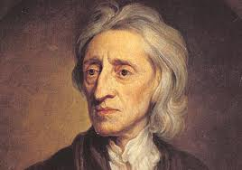
JOHN LOCKE ( 1632 - 1704 )

Slide 9
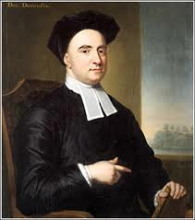
BISHOP GEORGE BERKELEY (1685 - 1753)

Slide 10
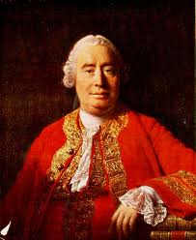
DAVID HUME ( 1711 - 1776)

Slide 11
A PROBLEM FOR RADICAL EMPIRICISM
PROBLEM: WHAT ABOUT OUR (PUTATIVE) KNOWLEDGE OF MATHEMATICS AND LOGIC?
5 +7 = 12
A STATEMENT CANNOT BE BOTH TRUE AND FALSE.
IF ALL MEN ARE MORTAL AND SOCRATES IS A MAN, THEN SOCRATES IS MORTAL.
THERE ARE NO THREE POSITIVE INTEGERS, X, Y, AND Z, AND A NUMBER N GREATER THAN 2, SUCH THAT X TO THE N-TH POWER PLUS Y TO THE N-TH POWER IS EQUAL TO Z TO THE N-TH POWER

Slide 12
RADICAL EMPIRICISTS HAVE TRIED TO “EXPLAIN AWAY” ALLEGED MATHEMATICAL AND LOGICAL KNOWLEDGE
“OUR ‘KNOWLEDGE’ OF LOGIC AND MATHEMATICS IS JUST EMPIRICALLY LEARNED RULES OF LANGUAGE. WE LEARN DEFINITIONS AND THE RULES FOR WHAT CONFLICTS WITH WHAT AND THE RESULT IS THAT WE APPEAR TO ‘KNOW’ FACTS THAT WE DID NOT LEARN FROM EXPERIENCE.”

Slide 13
REASON
WE SEEM TO GAIN KNOWLEDGE IN SOME CASES JUST BY THINKING, REASONING, AND INTUITIVE INSIGHT. IS , FOR EXAMPLE, MATHEMATICS REAL KNOWLEDGE? IT DOESN’T SEEM TO BE GAINED OR JUSTIFIED BY MEANS OF SENSORY EXPERIENCE. PERHAPS IT IS NOT REALLY KNOWLEDGE “ABOUT THE WORLD”.

Slide 14
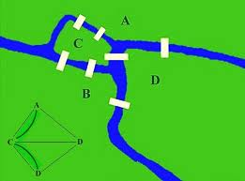
AN EXAMPLE WHERE WE SEEM TO LEARN SOMETHING ABOUT THE WORLD JUST BY REASONING
“THE PROBLEM OF THE SEVEN BRIDGES OF KONIGSBURG”:

Slide 15
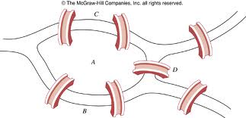
EULER’S PROOF THAT THERE IS NO SUCH PATH

Slide 16
THIS SORT OF THING, AND LOGICAL AND MATHEMATICAL REASONING IN GENERAL, PRESENTS A PROBLEM FOR EMPIRICISM
OTHER POSSIBLE PROBLEMS: ETHICAL KNOWLEDGE, RELIGIOUS KNOWLEDGE, AND … . HOW DO WE DRAW THE LINE? HOW DO WE DETERMINE WHETHER EMPIRICISM IS WRONG OR IF THE PUTATIVE COUNTER-EXAMPLES ARE REALLY KNOWLEDGE???

Slide 17
RADICAL RATIONALISM
(RR) WE CAN FIND OUT EVERYTHING THAT THERE IS TO KNOW JUST BY INTUITIVE INSIGHT, REASONING AND LOGICAL THINKING.
DESCARTES, SPINOZA AND LEIBNIZ ARE USUALLY CITED AS EXAMPLES OF RADICAL RATIONALISTS (THE LABEL DOESN’T REALLY QUITE FIT IN ANY OF THESE CASES).

Slide 18
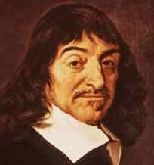
RENE DESCARTES (1596 - 1650)

Slide 19
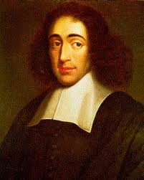
BARUCH (BENEDICT) SPINOZA (1632 - 1677 )

Slide 20
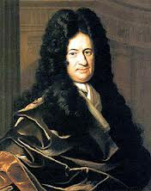
GOTTFRIED WILHELM VON LEIBNIZ (1646 - 1716)

Slide 21
THE PROBLEM OF THE CRITERION
HOW DO EMPIRICISTS DETERMINE THAT SENSORY EXPERIENCE IS THE CRITERION OF KNOWLEDGE? DO THEY TAKE CASES OF THINGS THAT ARE KNOWN AND TRY TO FIND A PRINCPLE THAT WILL FIT THEM? IF SO, HOW DO THEY DECIDE WHAT THINGS ARE KNOWN WITHOUT A CRITERION? IF SOMETHING (SAY “KNOWLEDGE OF GOD”) CONFLICTS WITH THE TEST, IS THE TEST WRONG OR IS IT NOT KNOWLEDGE? HOW DO THEY DECIDE?

Slide 22
THE PROBLEM OF OTHER MINDS
HOW DO YOU KNOW THAT “OTHER PEOPLE” HAVE CONSCIOUS EXPERIENCES, THOUGHTS, AND SENSATIONS LIKE YOU DO? HOW MANY CASES DO YOU REALLY KNOW OF WHERE BEHAVIOR APPARENTLY EXPRESSING THOUGHTS, EMOTIONS AND EXPERIENCE ACTUALLY DOES SO? VERY HASTY GENERALIZATION! MAYBE YOU ARE ALL ALONE.

Slide 23
LECTURE 12
WILLIAM ALSTON’S PERCEIVING GOD. THE EPISTEMOLOGY OF RELIGIOUS EXPERIENCE (CORNELL UNIVERSITY PRESS, 1991)

Slide 24
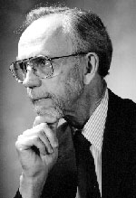
WILLIAM P. ALSTON (1921 - 2009 )

Slide 25
WILLIAM ALSTON IS ATTEMPTING TO SHOW THAT THERE MAY BE A KIND OF “PERCEPTION” OF GOD
HE ALSO CONSIDERS THE GENERAL PHILOSOPHICAL PROBLEM OF TRYING TO JUSTIFY A SOURCE OF KNOWLEDGE – TO SHOW THAT IT REALLY YIELDS WHAT IT PURPORTS TO OR, AT LEAST, TO SHOW THAT WE ARE JUSTIFIED IN ACCEPTING IT AS A RELIABLE SOURCE.

Slide 26
CHIEF AIM OF THE BOOK
“[T]o defend the view that putative direct awareness of God can provide justification for certain kinds of beliefs about God” [p. 9]
PRELIMINARIES:
How Alston is thinking about “(putative) direct awareness of God” [Ibid.]

Slide 27
DIRECT AWARENESS OF GOD AS TREATED BY ALSTON
What ‘territory’ it (the term) covers.
(B) Over what important differences it ranges.
(C) On which stretches of the ‘territory’ he will be concentrating on.

Slide 28
INITIAL EXAMPLES OF “MYSTICAL PERCEPTION”*
ALSTON PRESENTS 22 QUOTES FROM BOTH “PROFESSIONAL MYSTICS” AND ORDINARY LAY PERSONS WHO CLAIM TO HAVE HAD PERCEPTIONS OF GOD (OR “THE ULTIMATE”). HE DISCUSSES AND ANALYZES THESE SO AS TO EXTRACT A CHARACTERIZATION OF THE KINDS OF EXPERIENCE ON WHICH HE WILL BE FOCUSING. HIS SPECIFICATION OF MYSTICAL PERCEPTION DOES NOT AGREE EXACTLY WITH OTHER AUTHORS.
* ALSTON ADOPT A TERMINOLOGY THAT TAKES THE “SUCCESS ASPECT” OUT OF THE TERM “MYSTICAL PERCEPTION”. IN EFFECT, IT IS ALWAYS TO BE READ AS “MYSTICAL (PUTATIVE) PERCEPTION.”

Slide 29
PLEASE READ THE EXAMPLES CAREFULLY

Slide 30
MARKS OF MYSTICAL PERCEPTION
(1) MYSTICAL PERCEPTION IS EXPERIENTIAL IN A WAY THAT CONTRASTS WITH THINKING, REMEMBERING, IMAGING AND THE LIKE.
(2) MYSTICAL PERCEPTION CAN BE NON-SENSORY. THE SENSE QUALITIES OF WHICH ONE IS AWARE IN SEEING, HEARING, TASTING, SMELLING OR TOUCHING, ARE NOT ESSENTIAL TO SUCH EXPERIENCES.

Slide 31
PRESENTATION IS ESSENTIAL TO MYSTICAL PERCEPTION
THE REPORTS SHOW THAT THE EXPERIENCERS TAKE THE EXPERIENCE TO PRESENT SOMETHING TO THEM, NAMELY GOD.
JUST SO, SOMEONE LOOKING AT A TOMATO IS PRESENTED WITH AN OBJECT. EVEN A HALLUCINATION OF A TOMATO IS EXPERIENCED AS PRESENTING AN ENTITY – EVEN THOUGH NONE IS ACTUALLY PRESENT.

Slide 32
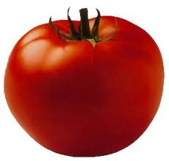
PHENOMENAL CONTENT OF EXPERIENCE OF SEEING A TOMATO

Slide 33
PHENOMENAL CONTENT OF A TOMATO HALLUCINATION

Slide 34
MP PURPORTS TO BE DIRECT OR IMMEDIATE PRESENTATION
EXAMPLE OF INDIRECT PERCEPTION:
WHEN YOU SEE A PERSON ON TELEVISION YOU ARE SEEING THEM INDIRECTLY. HERE YOU PERCEIVE SOMEONE, SAY THE PRESIDENT, BY PERCEIVING SOMETHING ELSE – THE IMAGE ON THE TELEVISION SCREEN.

Slide 35
EVEN ORDINARY PERCEPTION IS INDIRECT IN A CAUSAL SENSE
YOU LOOK AT A HOUSE. LIGHT STRIKES THE OBJECT AND IS REFLECTED INTO YOUR EYE, WHEREIN THE RODS AND CONES ARE STIMULATED, SENDING ELECTRICAL IMPULSES TO THE VISUAL CORTEX. THEREAFTER (SOMEHOW) YOU ARE CAUSED TO HAVE A VISUAL SENSATION. THIS IS STILL DIRECT PERCEPTION. YOU ARE NOT PERCEVING THE HOUSE BY PERCEIVING SOMETHING ELSE.

Slide 36
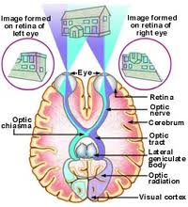
SEEING A HOUSE

Slide 37
THE VISUAL EXPERIENCE IS EVEN MORE DIRECT OR IMMEDIATE
YOU DO NOT LITERALLY PERCEIVE THE VISUAL EXPERIENCE, YOU HAVE IT. IT IS IN VIRTUE OF THIS (AND ITS CAUSES) THAT YOU SEE THE HOUSE.

Slide 38
WORD LIST
EPISTEMOLOGICAL CACOPHONY
PUTATIVE DOXASTIC
PHENOMENOLOGICAL DISPOSITIONAL
QUALIA ONTOLOGY
NOETIC PROPOSITIONAL
CIRCUMLOCUTION NONINTENTIONAL
INEFFABLE FAUTE DE MIEUX
AD LIBITUM

